Slide 1
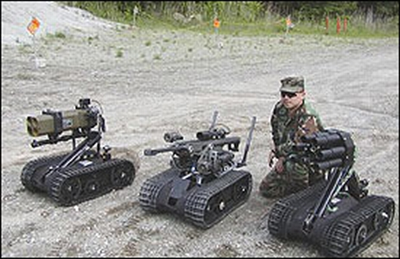
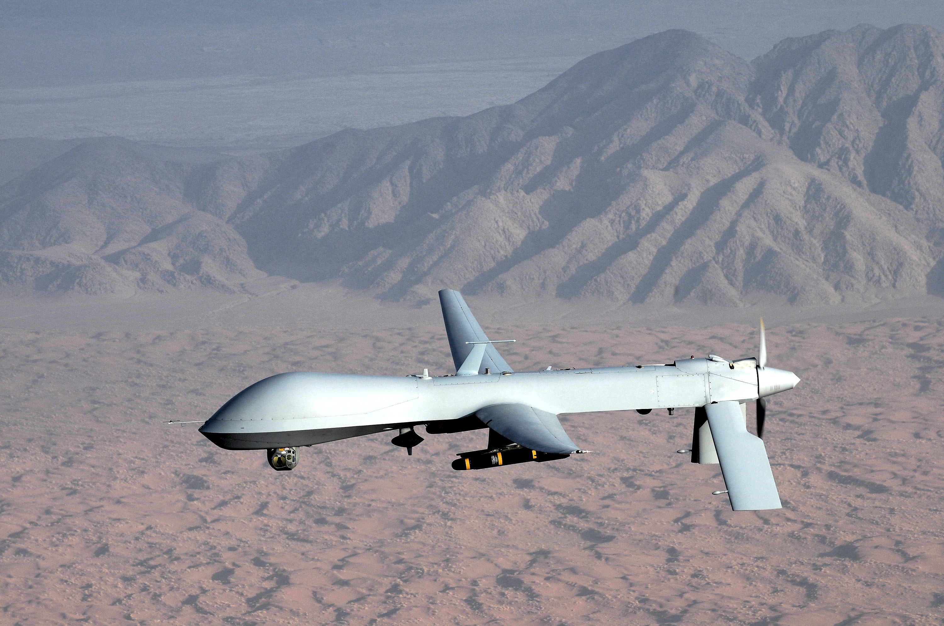
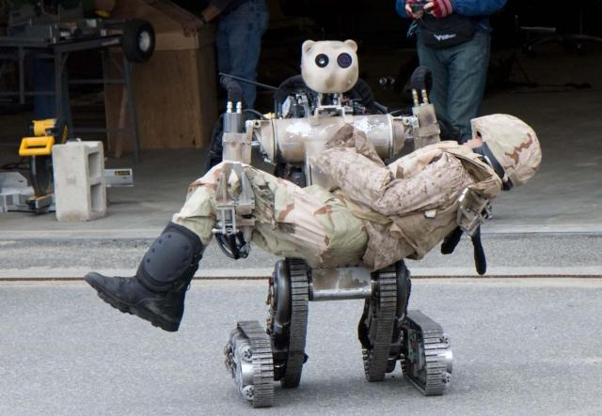
Autonomous Weapons and Cyberwar
ELEG 491

Slide 2
Let’s start with the ethics of automation:
“Automation” (NASA 1989): the explicit allocation of functions between humans and machines
Do most modern technologies automate?
What is the difference between automation and autonomy?
Why is autonomy important in ethics?

Slide 3
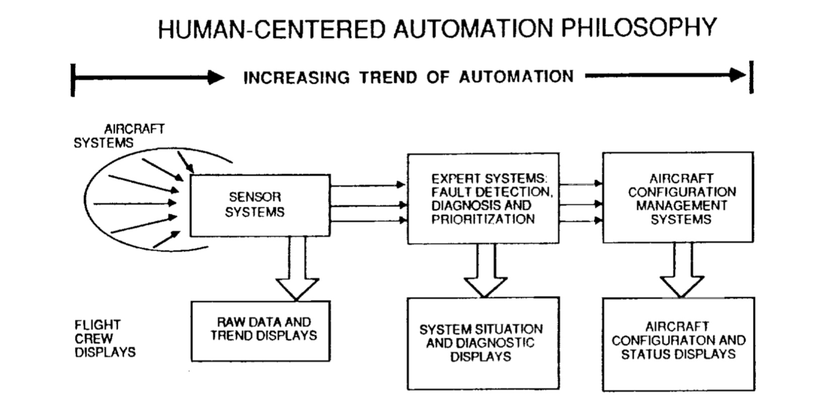
Human-Centered Automation (Graeber & Billings –NASA 1989)
https://ntrs.nasa.gov/archive/nasa/casi.ntrs.nasa.gov/19910001631.pdf

Slide 4
What are the “ethics of warfare”?
The “right to go to war” (jus ad bellum): right purpose, due authority, last resort, proportionality
The “right conduct in war” (jus in bello): noncombatant immunity, proportionality
The are many versions of this doctrine (starting with St. Augustine and Aquinas) that have been integrated with the Laws of War (LOW—see Arkin)
One ethical focus of most versions: minimizing casualties/proportionality

Slide 5
Can “smart wars” be “just wars”?
How do information technologies contribute to:
Avoiding military conflict?
Minimizing casualties of many sorts? (See Arkin’s 12 points regarding battlefield ethics)
Limiting the conflict in time and space?
What are the arguments against autonomous weapons? (See “An Open Letter from AI & Robotics Researchers”)

Slide 6
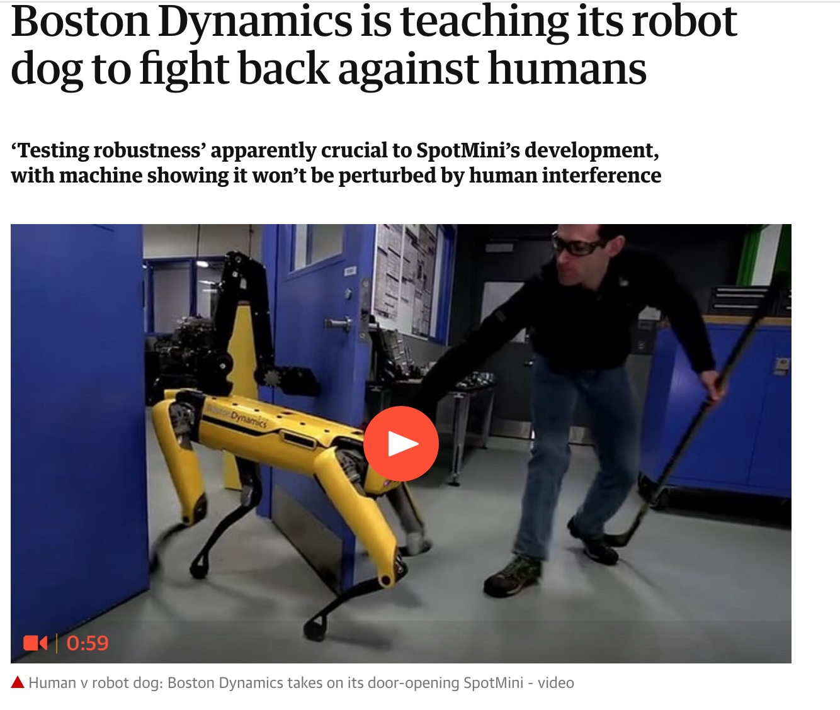
What is included in “automated” warfare?

Slide 7
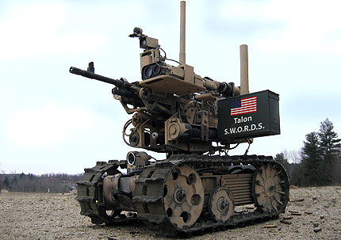
How are battlefield robots better? (see Arkin’s 6 points on performance advantages)
Lethal and intelligent
Able to be customized
Runs all day/night
Doesn’t get tired
Doesn’t bleed
Doesn’t panic

Slide 8
The benefits of lethal battlefield robots:
Able to distinguish “friend from foe”
Does better than human soldiers in distinguishing combatants from non-combatants
If it is destroyed, no people (usually) die

Slide 9
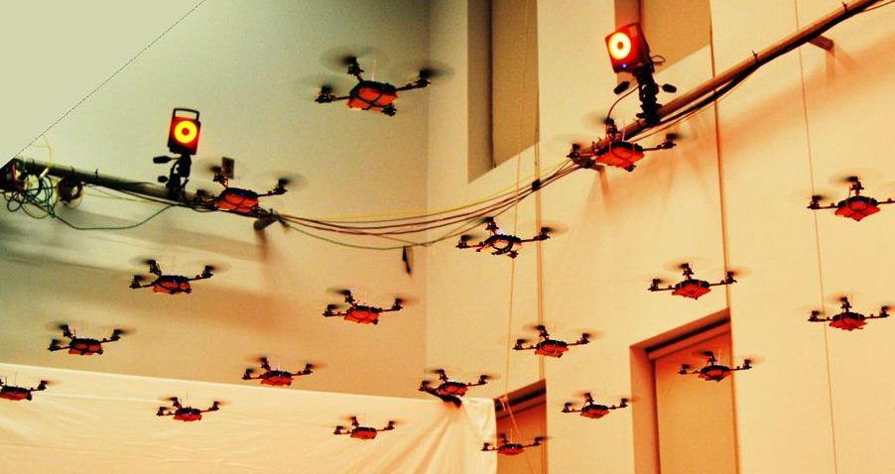
Surveillance and Attack Robots

Slide 10
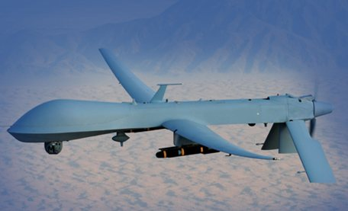
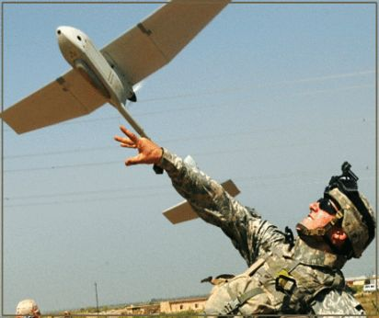
UAVs
Discriminating or Indiscriminate?
Do they “terrorize” non-combatant populations?
Will they fall into the “wrong hands”?
Do they respect sovereignty?

Slide 11
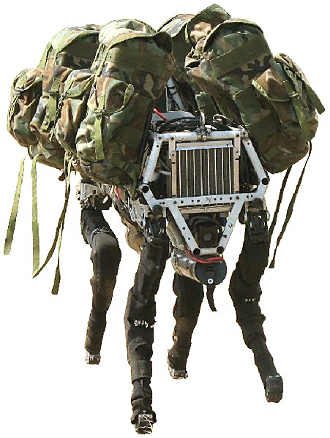
Transport Robots: Big Dog

Slide 12
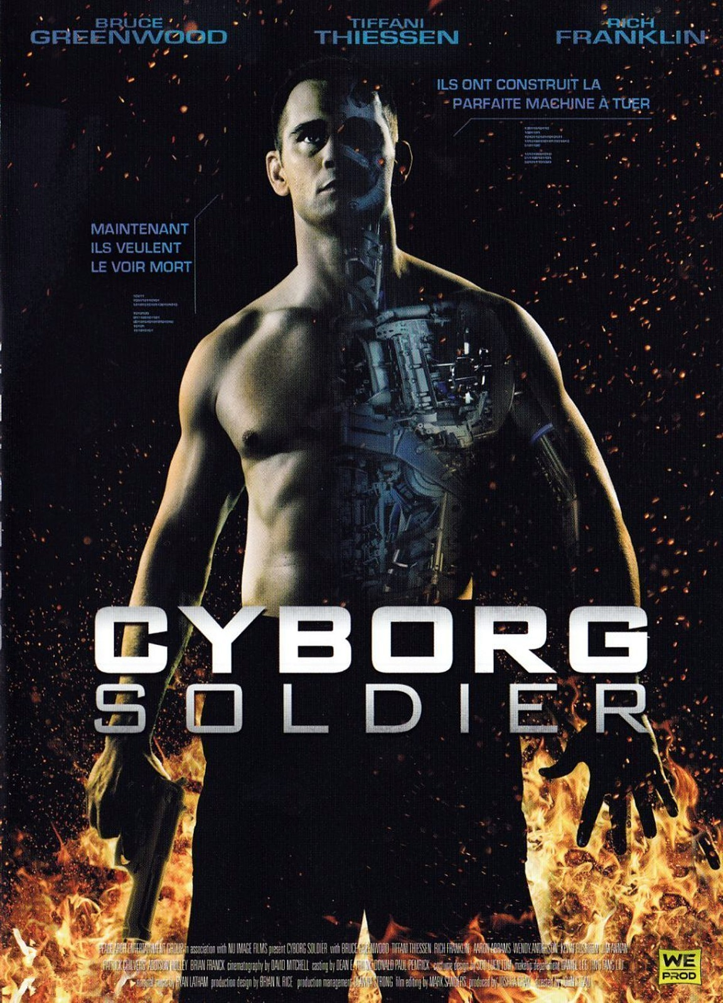
Hybrid Systems: Cyborg Soldier?
Exoskeletons—lethal and protective
Enhanced Perception
Networked “wearable computers”

Slide 13
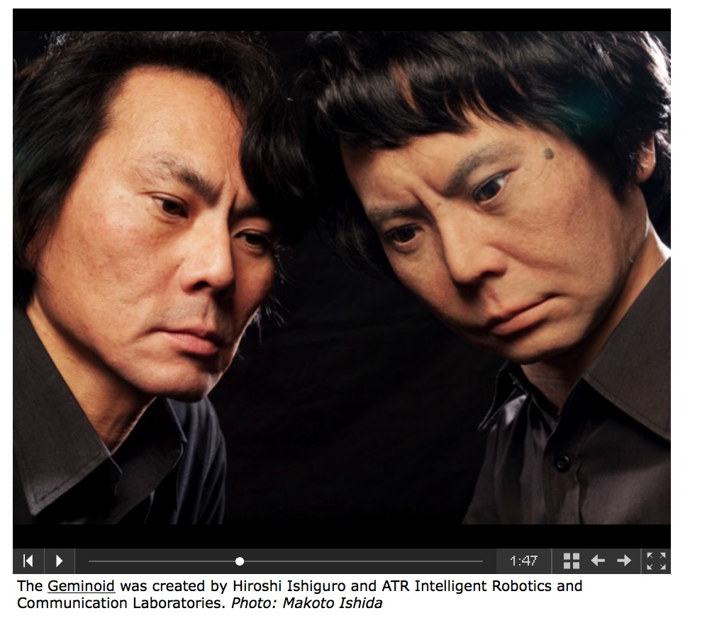
Do we have to worry about the “uncanny valley” (with humans and dogs)?

Slide 14
A worry: Forgetting how it “used to be done”
Do these technologies make it “easier” to go to war?
What about the psychological separation of the “controllers” from the battlefield?
Does computer-controlled warfare make all computer-controlled infrastructure “fair game”? (the STUXNET problem)
Will the distinction between actual warfare and warlike computer games begin to fade away?

Slide 15
Cyberwar
What is it? (There is currently no legal definition)
When/How did it originate?
What are the “ethics” of cyberwar?

Slide 16
Hacking as part of “The Technical Revolution” from Dr. Crash, (PHRACK vol. 1, no. 6, 1986; archived at phrack.org)
“In this file I will describe the underlying motives of the aware hackers, make known the connections between Hacking, Phreaking, Carding, and Anarchy, and make known the "techno-revolution" which is laying seeds in the mind of every hacker...The computer system has been solely in the hands of big businesses and the government. The wonderful device meant to enrich life has become a weapon which dehumanizes people...Hackers realize that the businesses aren't the only ones who are entitled to modern technology....Hacking is a major facet of the fight against the computer monopoly....Hacking must continue. We must train newcomers to the art of hacking. We must also increase computer Crashing. I know that crashing a computer seems a waste, but when there is no other way to subvert a business, their system must be shut down. ”

Slide 17
Cyberoffense (“The ethics of Hacking 101” Nakashima and Soltani, Washington Post 10/07/14)
Professors Shenoi (U. Tulsa) and Brumley (CMU) teach offensive hacking techniques to students (exploits and vulnerabilities) “Shenoi won’t even accept students who don’t promise to work, if hired” for NSA, DoE or other U.S. government agencies.
The “good guys have to keep up” argument
The “I can trust my students” argument
The “we aren’t selling exploits” argument
The “don’t drive research underground by regulation” argument
Cf. Knowles IBM dictum: “with great power comes great responsibility”

Slide 18
CyberWar and “just war theory”
Arquilla’s evidence that war has spread from the “physical” to the “virtual” realm: 2007 Estonia attack, 2008 Russian/Georgian attack, 2010 Stuxnet.
One major ethical concern with cyberwar is “inductive”: Where is this practice taking society?

Slide 19
The idea of war “with limits”
In modern times, interest in Just War Theory comes from the horror of chemical warfare in WWI and the Franco’s bombing of his own citizens in the Spanish Civil War (e.g., at Guernica)
Recall the tenets of Just War Theory: right purpose, due authority, last resort, noncombatant immunity, proportionality
The PPD-20 (2012) limits the offensive uses of cyberwar.
What changes will come with the new (2018) “Functional Campaign Plan for Cyberspace operations (FCP-CO)” in the Command Vision for US Cyber Command (Achieve and Maintain Cyberspace Superiority—see Supplementary Readings)?

Slide 20
“Suppose U.S. cyberforces engage in a counter-hack of a foreign power’s electricity grid. This act would most likely violate_________.”
A. right purpose
B. due authority
C. last resort
D. noncombatant immunity
E. proportionality

